Slide 1
QUANTITATIVE MANAGEMENT MODELING (FINAL PROJECT)
(MATHEMATICAL MODELLING)
Bharath Chennu, Michael Geist, Elmy Luka

Slide 2
GOAL OF THE PROJECT
This assignment is to define, formulate and solve a mathematical optimization model. We were given guidelines such as 12 students in class and asked to choose three different factors to allow us to create the best groups.
The goal is to ensure maximize the chance that each group will do well on the project.

Slide 3
Data Collection and Choice Of Factors
We have considered a total of 12 students, and we will be forming four groups of three students in each group. Students were not allowed to be in multiple groups.
The following are the factors considered affecting the success of group projects.
GPA - Scale= 0- 4
COURSE GRADES - Scale= 0 – 100 (We assumed that if they were below 50 they would have withdrawn from class).
ATTENDANCE - Scale= 0 – 25 (25 classes at this point of data collection)

Slide 4
Method Used
Integer linear programming is a mathematical optimization problem that helps to find the optimal solution and restricts the output to an integer.
This model fits very well with the problem explained in this project because the objective function is to maximize the chance that each group considered will do well in the project.
We created our objective function based on Class grades and each student getting assigned to four groups. Our constraints were GPA and Attendance.
Objective Function
The Constraints are as follows:
The sum of GPA cannot be greater than 12 for any of the four groups
The class attendance cannot be greater than 75 for any of the four groups
Each student cannot be in one group
There are only four groups of three students
All Xij are integers 1-4 for i and 1-12 for j

Slide 5
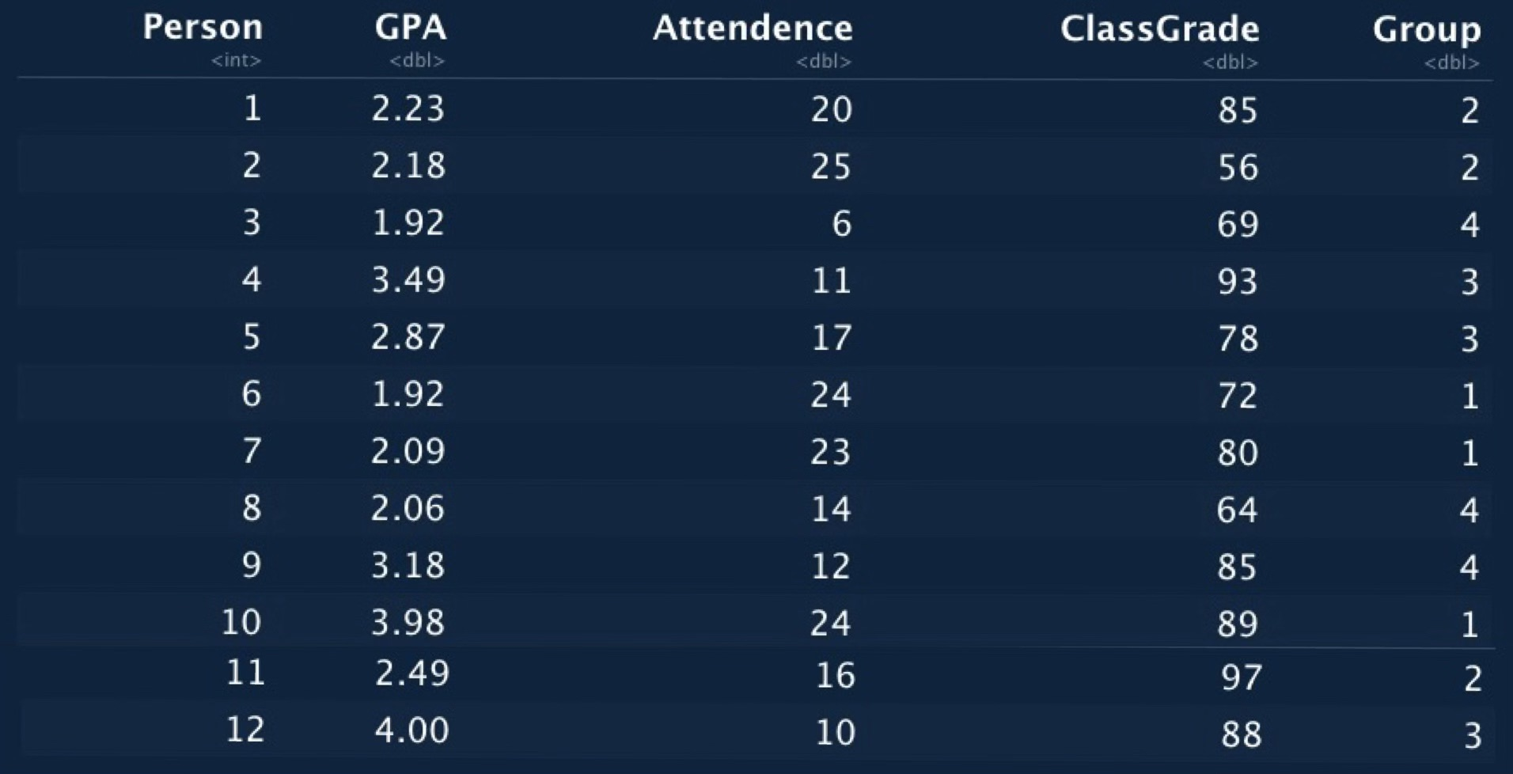
FINDINGS
GROUP-1 = Student- 6,7,10. GROUP-2 = Student-1,2,11 GROUP-3 = Student- 4,5,1 GROUP-4 = Student- 3,8,9
Group 1 has the highest attendance however GPA is a good mix. Group 3 has the students with the one of the highest GPA and course grades, but all do not attend class at the same time.
Group 4 has the least attendance when compared to the other groups however grades are better than the lowest. Group 2 has mediocre GPA with only one student (2) having the highest attendance and one student (11) having having the highest course grade amongst all the students.

Slide 6
Conclusion
In all the 4 groups formed, it can be determined that attendance does not contribute much towards a group doing well on the project, while GPA and the course grade can be considered as the two important factors considered for good performance in a class group project.
In each group we have at least one person having a high GPA and course grade.
Therefore, based on this analysis we can assume that every group has the probability of performing well on the group project.

